Slide 1
CLASS OF 2026
INTRO to M4 YEAR SERIES
Session #1-
Overview, Scheduling, Planning
Series sponsors:
Office of Educational Affairs
Office of Student Affairs
Office of Registration and Records

Slide 2
What most M3s what to know now:
What is the M4 calendar
Track information
Lottery information
How do I organize my calendar/year
Electives/aways
When should I take Step 2

Slide 3
Today’s Agenda
Fourth Year Academic Overview
Clerkship Track System and Calendar
Required clerkships
Elective requirements
VSLO registration
USMLE Step 2 requirements & timing
Lottery Process
Residency Planning: Future Meetings

Slide 4
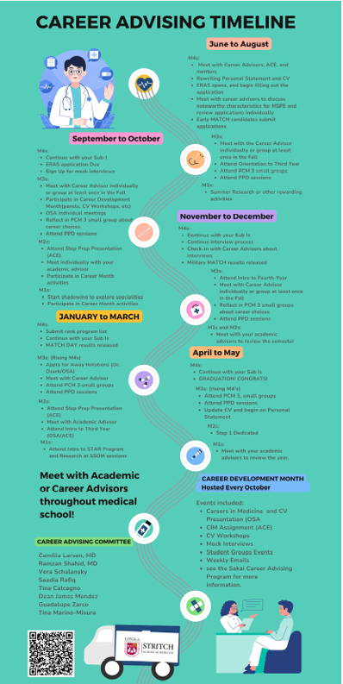
Career Advising Timeline which was introduced last month at the PPD session
4-year guide divided by months to keep you on track towards residency.
On Career Advising Sakai

Slide 5
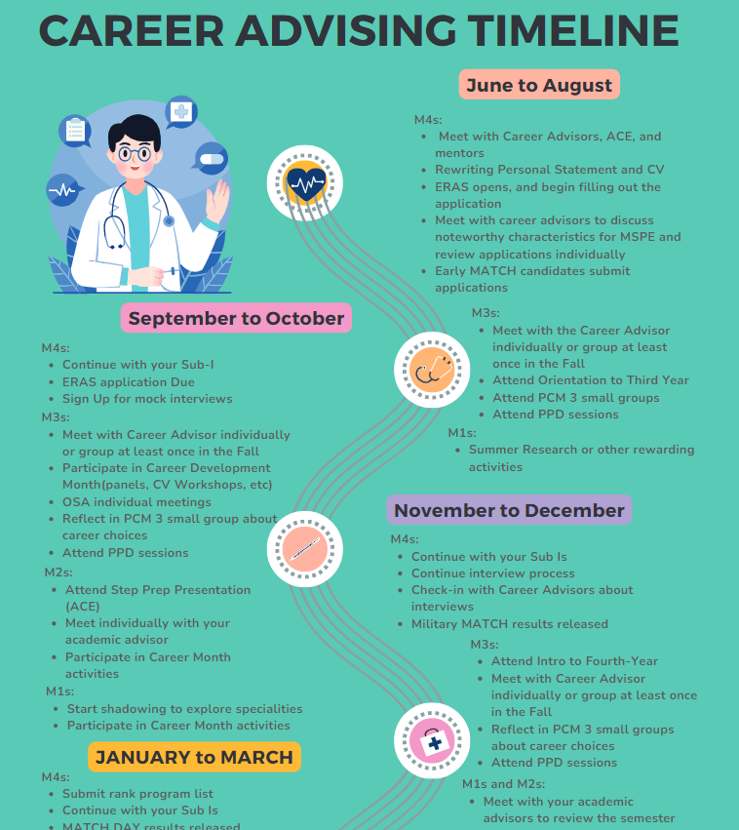
Notes:
As promised, today is the first of the Intro to M4 year talks.

Slide 6
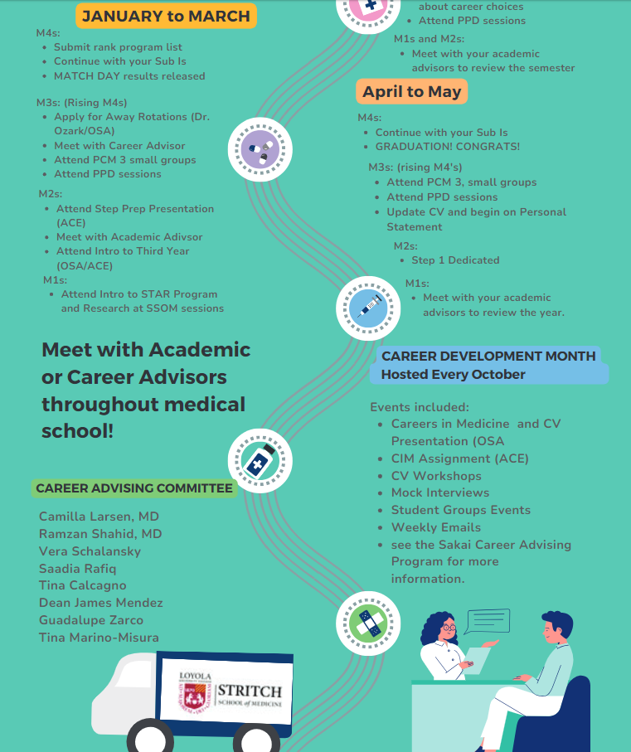
Notes:
Coming up, from Jan to May, there are also ‘to-do’s’ and programmatic offerings.

Slide 7
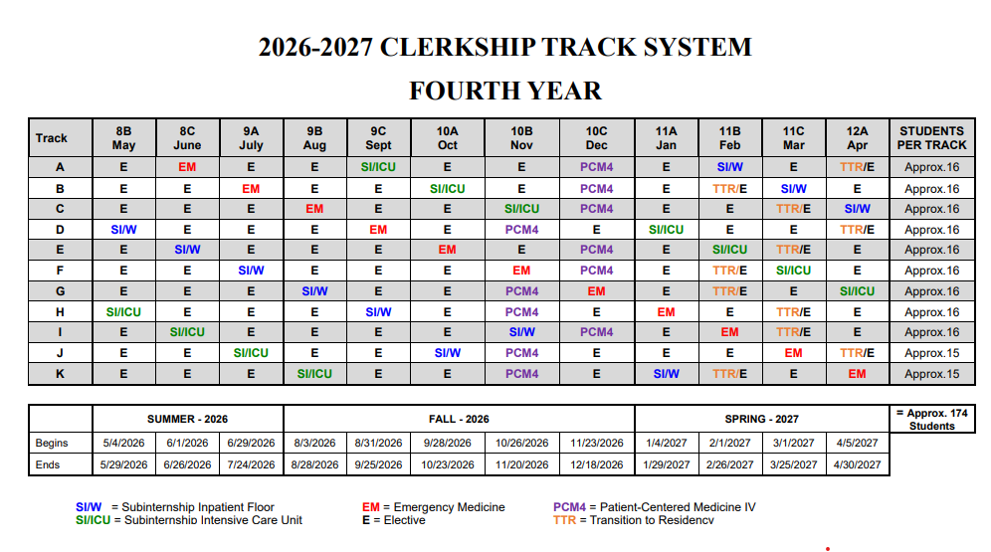
M4 Clerkship Track System
Class of 2027
Notes:
There are 11 tracks available in your M4 year. Last year: 76% of students received 1st choice, 20% 2nd or 3rd choice, 4% received 4th choice or lower.

Slide 8
Calendar details:
Year 4 start date:
  First period block starts Monday, May 4th, 2026 (May = Period “8B”)
Breaks:
  Summer: End of July/Early August (7/25/26 - 8/2/26)
  Winter: End of Fall Semester (12/19/26 - 1/3/27)
  Spring (not usually the case): 3/26/27 – 4/4/27)
Match Day and Graduation dates are tentative.
  Match Day tentatively March 19th
  Graduation tentatively either on Sat. May 9th or 15th, 2027
    Commencement announced by LUC Fall 2026

Slide 9
Your M4 Year-
Readiness for Residency
Mix of required rotations, courses and electives to allow you to be prepared to enter a rigorous residency

Slide 10
Fourth Year
Snapshot of Requirements
12 weeks of core clerkships:
  Emergency Medicine, Sub-I Ward, Sub-I ICU
4 weeks required PCM-4 course (Nov or Dec)
2 weeks required Transition to Residency Course (TTR)
  Offered in Feb, March or April in the first 2 weeks
22 weeks of elective credit required for graduation
  30 weeks elective time available in M4 year for on-track students
  Must complete at least 12 weeks of clinical electives in M4 year
  Must complete at least 12 weeks of full-time coursework in final semester (full-time required clerkships or elective courses)
Bioethics Requirements
  4 Ethics Grand Rounds and a paper
USMLE Step 2 CK

Slide 11
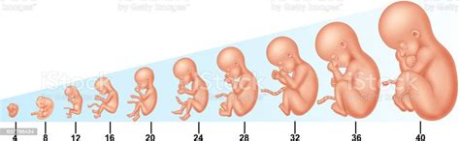
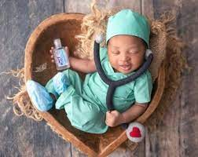
How long are the required elements of your M4 year?
40 weeks!
What else takes 40 weeks?

Slide 12
M4 Math:
There are 48 weeks available in your M4 year for rotations
12 weeks of core clerkships (EM, Sub-I ICU, Sub-I Ward)
+ 4 weeks PCM-4
+ 2 weeks TTR Course
----
18 weeks required rotations/courses
+22 weeks of electives to graduate (you may have up to 6 weeks already)
------
40 weeks or less needed
Discretionary Time available to cover non-clinical time (name will be changing)
Other tasks:
Bioethics Requirements
USMLE Step 2
Must complete at least 12 weeks of full-time coursework in final semester
Must have 12 of the 22 weeks of electives be clinical electives

Slide 13
Readiness for Residency:
M4 Core Rotations
3 Core Clerkships:
  Sub-Intern Ward
  Sub-Intern ICU
  Emergency Medicine

Slide 14
Purpose of Required Clinical Rotations:
Sub-Internships and EM
Sub-Is:
  Focus on skills and attitudes necessary to care for hospitalized and critically ill patients
  Assuming the responsibilities of the PGY1 resident
    6 days/week, limited extra days off
    Writing orders/making management decisions
  Multiple wards/ICUs to meet needs/ limited opportunity for 1 away sub-I to count
EM:
  Triage/stabilize/manage acutely ill, undifferentiated patients
  Rotate among 2 different settings (University + Community or VA setting)
  Naples, Florida will be a site starting June 2026 (more info to come)
This 4th year exposure is a strength of our school, a benefit for residency prep, and an advantage during interviews.
Notes:
Some students wonder why there are rotation requirements in M4 year.

Slide 15
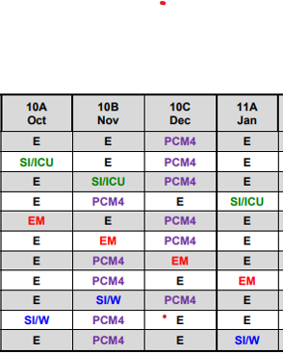
We want you to interview!
Track schedule was designed to have no more than one required rotation in the typical 4-month interview range

Slide 16
Readiness for Residency:
M4 Required Courses
2 Required Courses:
  PCM-4
  TTR

Slide 17
Required Rotation:
Patient-Centered Medicine-4
Offered in November or December
Asynchronous curricula allowing time for interviewing
  Schedule most interviews during this month
Can swap November and December only if no required rotation in opposite month
All asynchronous!
The course is pass/fail/meets with concern

Slide 18

Required Course:
Transition to Residency (TTR)
2-week high yield course covering essential topics for intern year
  First week- general topics for all interns
  Second week- specialty specific training
Residency programs like this/increasingly expecting this experience of graduates
Tracks have the TTR course in first 2 weeks of Feb/Mar/Apr
  Weeks 3-4 can be E(lective) or DT

Slide 19
Transition to Residency (TTR)
2nd week of TTR sessions are focused toward residency-specific topics (medicine/pediatrics/surgical/anesthesia/EM/OB)
  Adult medicine specialties can choose any TTR session
  Pediatric focused specialties should choose the TTR in Tracks: 11B (Feb) for best experience
  Surgical specialties/anesthesia/EM should choose the TTR in Tracks: 11C (Mar) or 12A(Apr) for best experience
  OB should choose the TTR in Track 11C (Mar)
  FM can decide Adult or Peds focus
  TY or Prelim year, consider Medicine or Surgery path
Switching sessions for TTR will be subject to availability (should not count on it)
It is OK if you cannot attend your specialty-specific session, still will be high-yield, just not as customized.

Slide 20
M4 year:
Readiness for Residency
Time of Formation
40 weeks to create a child. 40 weeks to prepare for your intern year.
Be thoughtful in creating your academic plan
~$76,073/12=$6,339 per month during M4 year
You are your best investment
Resources available to help advise

Slide 21
Readiness for Residency: Electives
22 weeks of electives to graduate
12 weeks need to be clinical
Electives can be taken intramurally
In our elective catalog (LUMC/HVA/MNH…)
Electives can be taken outside of Loyola/Hines
AKA Audition rotations
The PPD session on January 14 will cover electives in more detail

Slide 22
January 14- PPD3
Intro to M4 Year Session# 2
Electives
Specific information about making an elective plan
Which rotations
Educational plan
Extramural/Away/Audition rotations
VSLO is the AAMC application program for applying to many programs

Slide 23

Extramural/Away/Audition rotations
Up to 12 weeks permitted usually through another US med school
VSLO= Visiting Student Learning Opportunity
  Web-based application platform developed by the AAMC
  >75% of US medical schools use VSLO to process visiting student applications; the others use their own applications
ORR will be sending you VSLO information in next few weeks
  We will be presenting detailed information January 14th
Notes:
Some quick information about electives meant as an introduction

Slide 24
Discretionary Time (DT)- name will be changing
Any time left over after you have met requirements for graduation can be taken as Discretionary Time
  Actual amount will vary depending on student circumstance
  Off-cycle students may have little to no DT available (i.e. you may have already used this up)
Can use DT as:
  Time for Additional Elective Opportunities
    You are allowed 12 weeks in one specialty area
    You are allowed 12 weeks extramural
  For USMLE Step 2 study time
  Residency Interview time off
  For extramural calendar adjustment (other school’s calendar doesn’t match Stritch’s)
  For remediation needs
  For personal needs

Slide 25
USMLE STEP 2 CK
First attempt Step 2 exam must be taken by the end of fall semester of fourth year (by December 31, 2026)
Residency programs increasingly want proof of successful completion of Step 2 during interview process
Many want score to offer interview (i.e. score needed by late September)
Majority require score (or proof of passing) before ranking candidates (i.e. score needed by mid-January 2027)
USMLE Step 2 CK must be PASSED to graduate. If a 2nd attempt is needed, scores must be received at least two months prior to graduation (mid-March 2027)
Scores reported approximately 2-3 weeks after test date

Slide 26
Capstone
Capstone is a requirement of M3 year
Involves multiple acute care SP visits in Clinical Skills Center
Write up, ddx and plan after each visit
1:1 feedback by clinical faculty member
4 dates available in late March/early April
Off cycle students will do this exercise in fall

Slide 27
What to do now:
Look through the track calendar
Think about any special circumstance you may have
  Do you have to repeat or make up a clerkship and intend to graduate on time?
    Then Tracks with “E” in the beginning is what you will need
  Are you going into EM? You will want tracks with EM in June/July
    Home rotation before away
    EM not offered in May, if you don’t get your preferred track, switches happen
When are you going to take Step 2?
  Ideally post a score before ERAS/Residency apps
    Last week in September is usual date of app release

Slide 28
What else to do now:
Meet with your Career Advisor about any specific/recommended needs for your specialty
  How many away rotations required, when to do them
  Do you need a home rotation before an away?
  Your advising requirement has 2 formal meetings needed this year: 1st and 2nd semester. See Sakai.
When does your specialty interview typically?
  Avoid required rotations during that time
    PCM4 is designed to allow interviews
    You can take DT during an “E” slot on track

Slide 29
Off Cycle Students or Jan 2028 Grads:
If you can graduate May 2027
You will receive a lottery number
OSA will reach out to you to let you know if you are not receiving a lottery number
Must finish all M3 rotations before starting M4 year
Exception is Neurology- do prior to graduation
Off cycle rotation calendar may not be known far ahead of time
You will move into open spots when rising M3 students delay Step

Slide 30
M4 Clerkship Track System
Class of 2027
Notes:
There are 11 tracks available in your M4 year.

Slide 31
FAQ:
If you still have to sit for Step 1:
  Still participate in Lottery, but if you are significantly off-cycle or do not pass- you will be given a custom track based on availability.
  Deans Mendez and Zarco will be in touch
Switching req rotations can happen, but don’t base a decision on it.
PCM 4 can be taken in Nov or Dec
  Switching OK if opposite month has “E”
Only 3 tracks have a required rotation in November.
  If your specialty interviews ONLY in November, you should NOT choose that track.
Try to choose a track that has your specialty for TTR (ideal but not required)

Slide 32
Upcoming weeks:
Handout emailed by ORR
Clerkship Track System and its Policies
Information about computer generated Lottery Numbers
Information about Fourth Year Calendar
VSLO information
Timeline for Elective Registration Calendar
  FYI: May electives start registering in February!
Notes:
Our attempt is not to overwhelm you today, but to provide an overview of the next few months and give you the information you need at the time you need it.

Slide 33
“Intro to M4 year Series”
Future Sessions:
PPD January 14th
  Electives: Educational plan and registration process
  More about Away Rotations
  Sub-I possibility at outside program
PPD February 11th and PPD April 8th - OSA
  Feb and April content being finalized
    Personal Statement, LORs, CVs
    MSPE
    Residency Application Process
    OSA Meetings
    Step Prep
    Timeline for M4 year tasks

Slide 34
Other offerings:
OSA will also be offering additional informational sessions in M3 and M4 years
ACE/Career Advising has additional offerings during your M4 year

Slide 35
Online Resources
Loyola SSOM Elective Catalog: https://www.luc.edu/stritch/regrec/electivecatalog/coursecatalog/
AAMC Extramural Elective Compendium: https://services.aamc.org/eec/students/index.cfm
USMLE STEP 2 info: http://www.usmle.org/step-2-ck/
Visiting Student Learning Opportunities: https://vslo.aamc.org/vslo

Slide 36
Questions?
Reminder that these slides are available on Advising Sakai under PPD session and will be on Registrar website
This session was recorded

